Slide 1

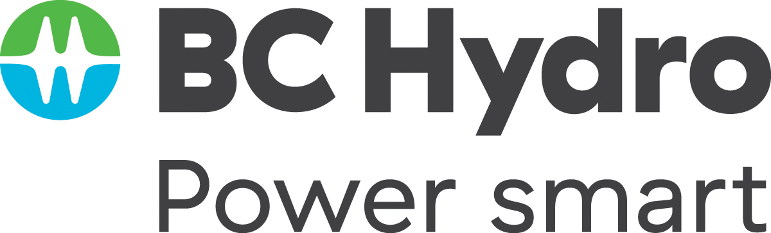
Twice as nice?
A Longitudinal Field Study of Separate vs. Combined Nudges for Household Laundry Behaviours
Notes:
Today will be a bit different – the full story of a project, rather than the perfect story tied with a bow. Looking forward to your questions and suggestions – please jump in any time.

Slide 2
Co-Authors & Partners
UBC
David Hardisty
Kirstin Appelt
Sid Mookerjee
Yanwen Wang
Jiaying Zhao
BC Hydro
Arien Korteland
Valerie Rodrigues
Netu Sidhu

Slide 3
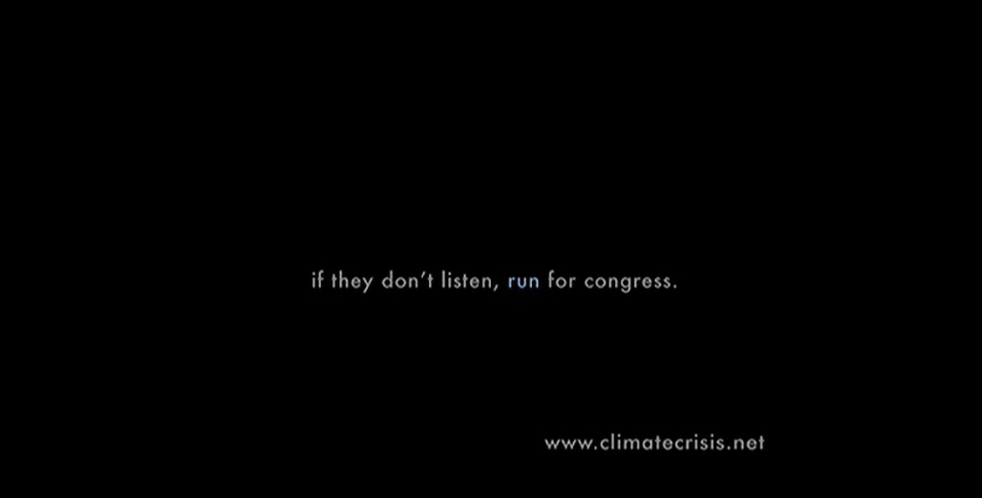
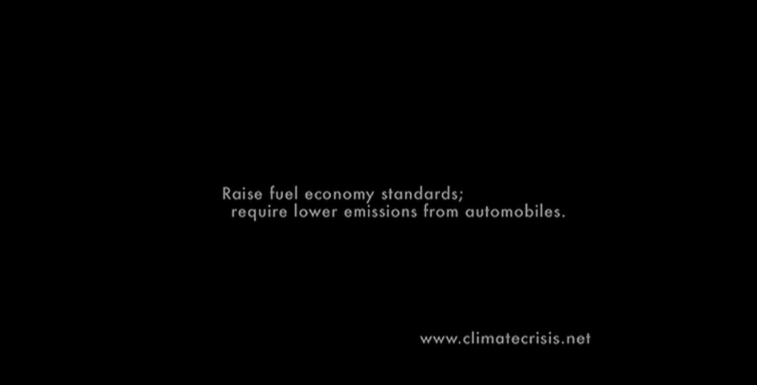
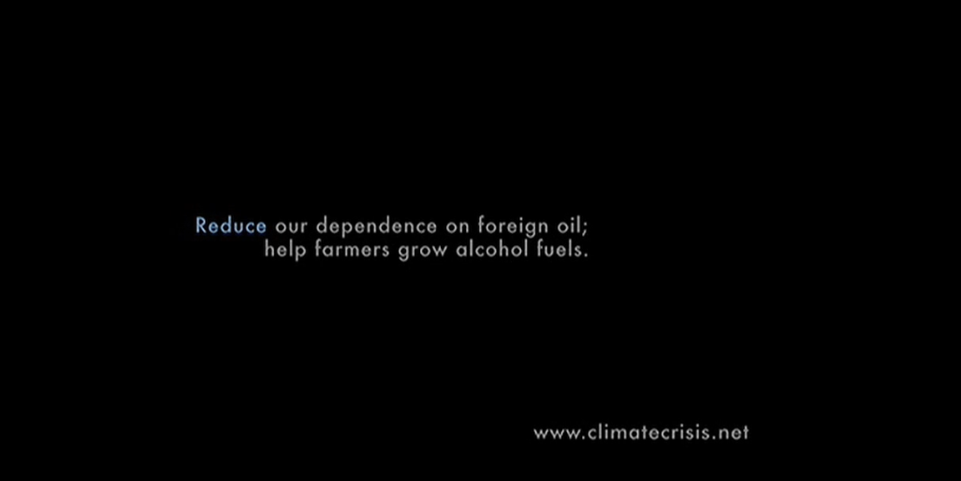
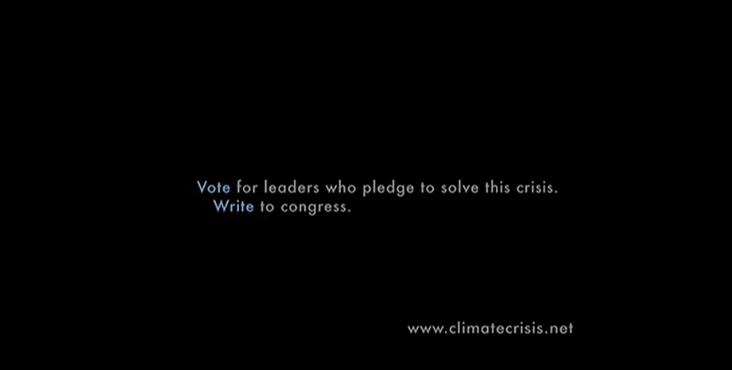
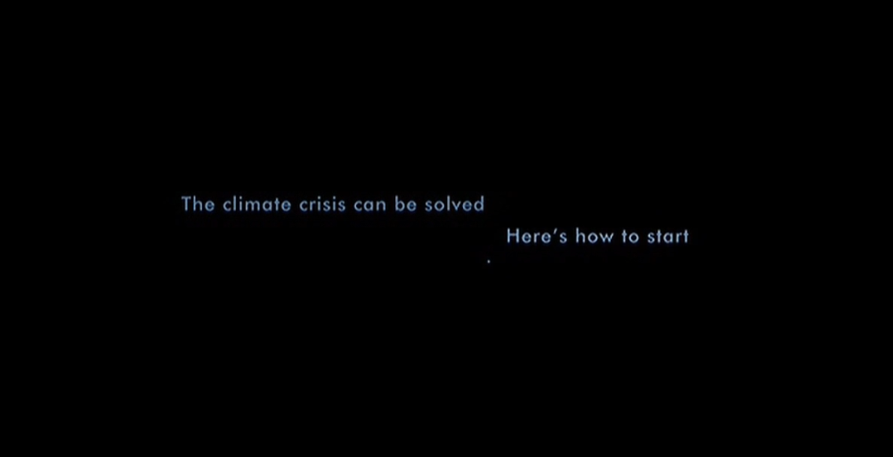
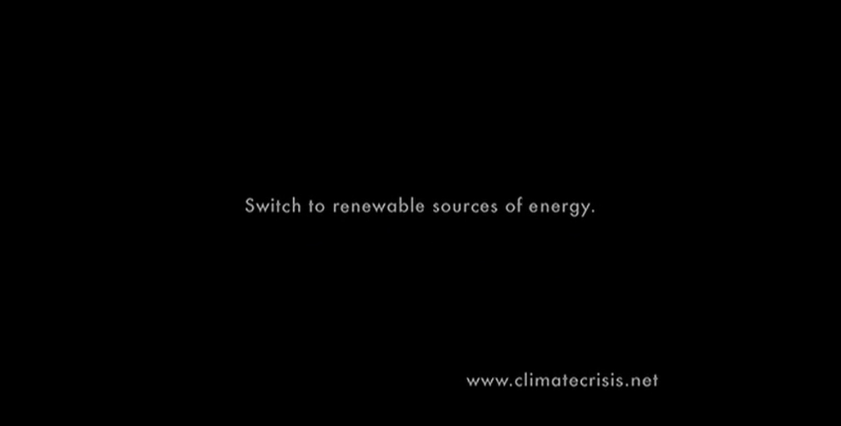
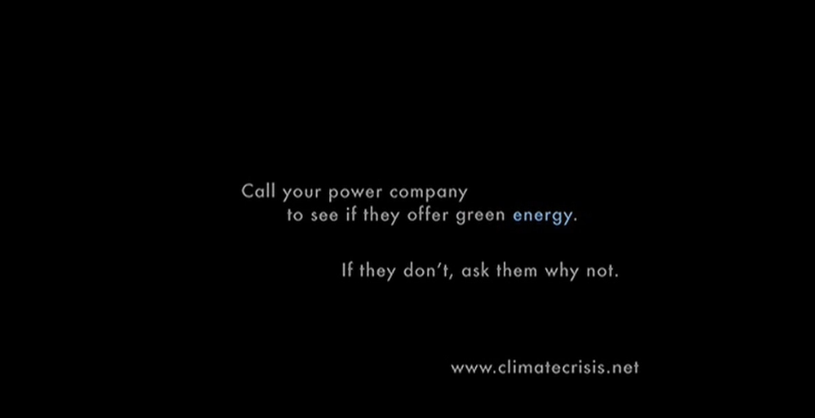
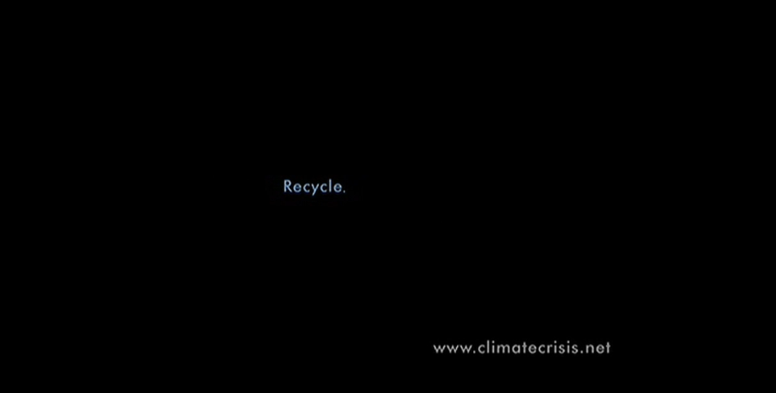
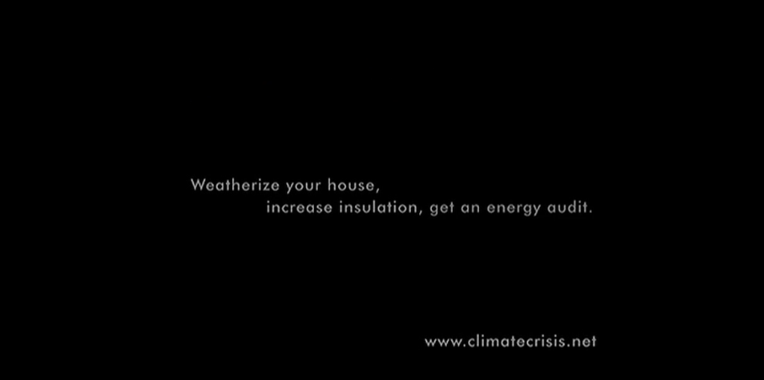
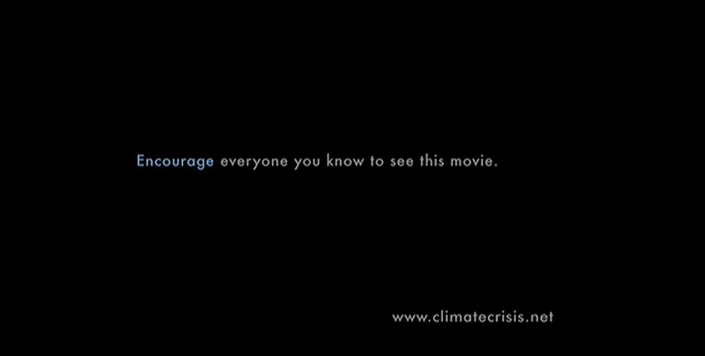
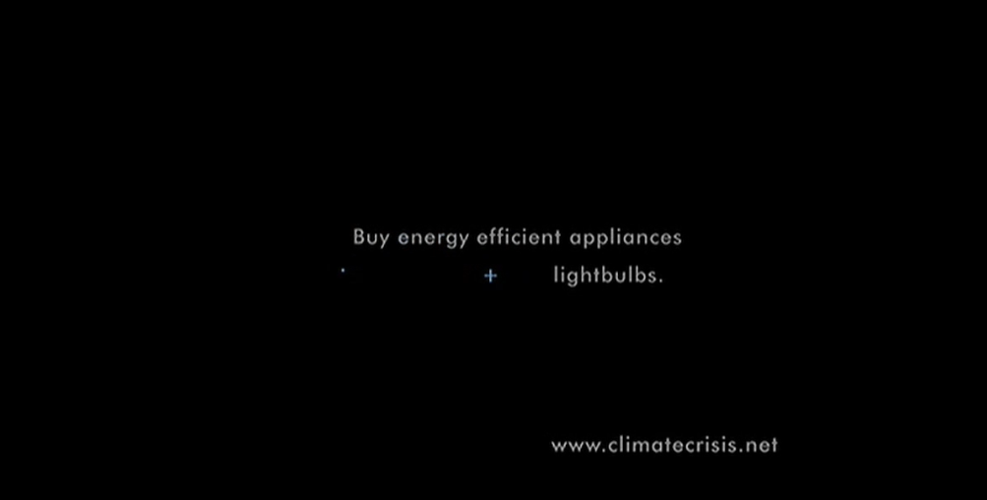
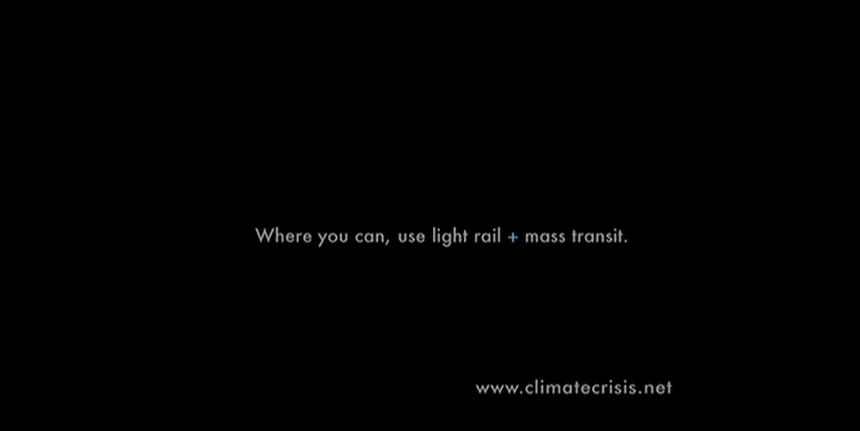
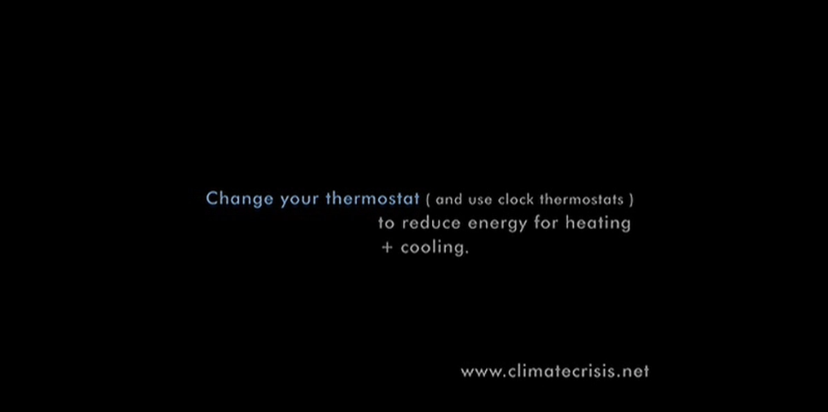
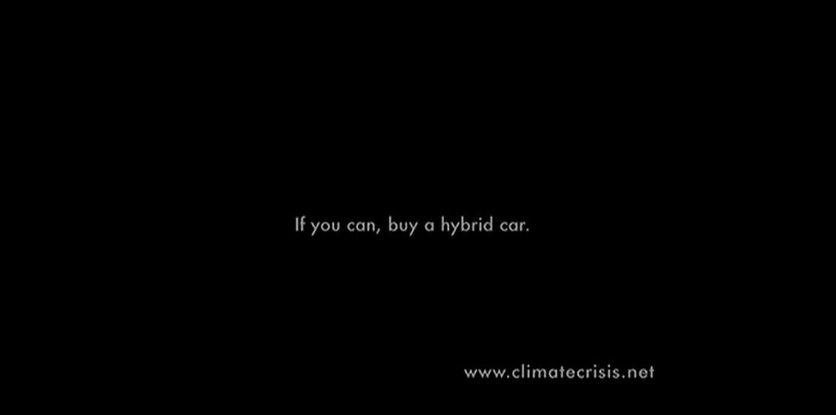
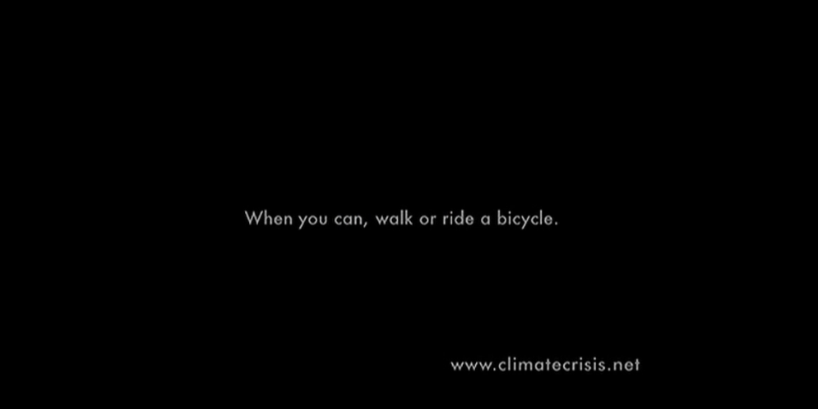
Motivation
Who’s seen An Inconvenient Truth?

Slide 4
Key Questions
How to nudge sustainable behaviour change?
Better to use “prosocial” motivation, “pro-self” motivation, or both together?
Better to make many questions for behaviour change, or focus on one?

Slide 5
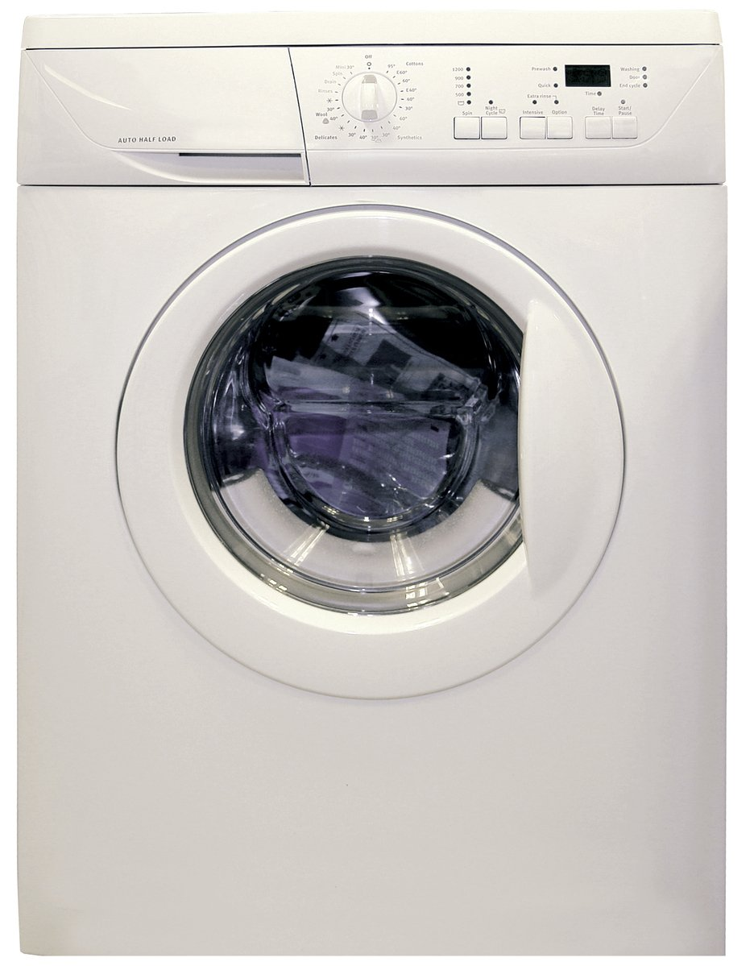
Practical Impact
Washer and dryer make up to 12% of home energy use
(BC Hydro data)
Little research on changing laundry behaviour
Identifiable via spikes in metered data (in theory)
Image credit: https://en.wikipedia.org/wiki/Clothes_dryer#/media/File:Clothes_Dryer.jpg
Notes:
Image source: https://www.freeimages.com/photo/washing-machine-1418432

Slide 6

Agenda
Literature review
Pilot surveys (Feb 2021 – Apr 2021)
Main study design (June 2021 – May 2022)
Hypotheses
Behavioural intention results
Self-report results
Behaviour logging results
Energy meter results
Summary & Conclusions
Notes:
Image source: https://www.freeimages.com/

Slide 7
Literature Review

Slide 8
Literature Review
Short-term vs. long-term effects
  Most behaviour change studies only examine a single choice
  Dynamic energy competitions can be effective long-term (Schultz et al 2007; Wemyss et al., 2019), but only while the feedback is maintained
Spillover effects
  Meta-analysis shows positive spillover effects on intentions, but small negative effects on actual behaviour and policy support (Maki et al., 2019)
  Single request vs multiple simultaneous requests??
Monetary vs. environmental motivation
  Financial and environmental framing both improve energy efficient purchases, especially when scaled up (Camilleri & Larrick 2014; Hardisty et al. 2018; Ungemach et al 2018)
  Financial and environmental messaging both improve energy saving intentions (Steinhorst, Klöckner, & Matthies, 2015; Steinhorst & Klöckner, 2018), but not actual behaviour (Steinhorst & Klöckner, 2018)

Slide 9
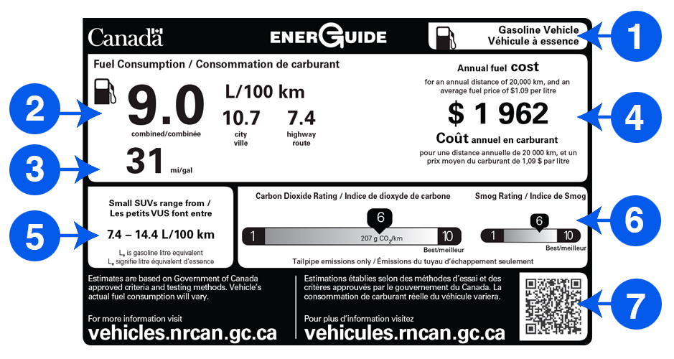
Literature Review
Image credit: https://www.nrcan.gc.ca/energy-efficiency/energuide-canada/energuide-vehicles/21010

Slide 10
Pilot Surveys

Slide 11
Pilot Surveys
Perhaps a decal on the laundry machine could provide a lasting nudge?
  Constant reminder
  Attractive
  Low-cost
  What‘s the right message?
6 pilot surveys explored and pre-tested ideas (Feb 2021 – Apr 2021)
Hypothetical scenarios with online samples from Prolific.co
10-year dollar cost and CO2 labeling can nudge energy efficient purchases. Might these motivators work for laundry behaviours as well?

Slide 12
Pilot Survey 2
600 participants assigned to one of 13 conditions
Between-participants design:
2 (gain vs. loss framing)
x 2 (time horizon: per load vs 10-year)
x 3 (motivators: money vs. energy vs. both)
+ control

Slide 13
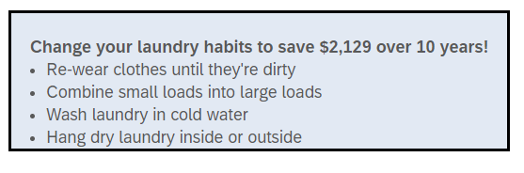
Pilot Surveys – Survey 2
Money-gain 10-year condition
Willingness to engage in conservation behaviour (1=Not at all likely, 5=Very likely):
“Rewear clothes until dirty, Combine small loads into large loads, Wash laundry in cold water, Hang dry laundry inside or outside”

Slide 14
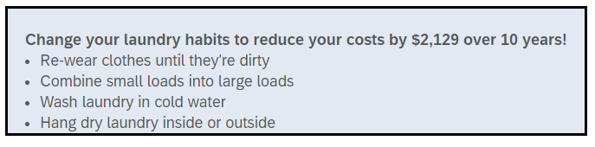
Pilot Surveys – Survey 2
Money-loss 10-year condition

Slide 15
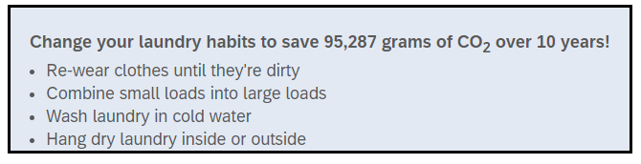
Pilot Surveys – Survey 2
CO2-gain 10-year condition

Slide 16
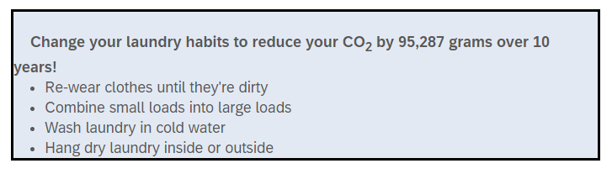
Pilot Surveys – Survey 2
CO2-loss 10-year condition

Slide 17
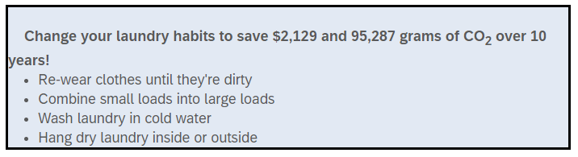
Pilot Surveys – Survey 2
Combined Money-Gain + CO2-Gain Condition

Slide 18
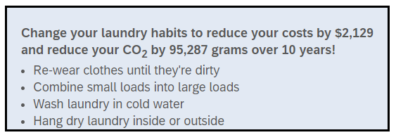
Pilot Surveys – Survey 2
Combined Money-Loss + CO2-Loss Condition

Slide 19
Pilot Surveys – Survey 2 Design Summary
Money-gain condition
CO2-gain condition
Money+ CO2-gain condition
Money-loss condition
CO2-loss condition
Money+ CO2-loss condition
Willingness to place decal (1= Definitely not, 5=Definitely yes): “Would you be willing to place a removable decal or sticker with this message on your washer or dryer?”
Willingness to engage in conservation behaviour (1=Not at all likely, 5=Very likely): “Rewear clothes until dirty, Combine small loads into large loads, Wash laundry in cold water, Hang dry laundry inside or outside”

Slide 20
Pilot Survey 2
Which condition do you predict was most effective in Pilot Survey 2?
Control
Money Gain
Money Loss
CO2 Gain
CO2 Loss
Money + CO2 Gain
Money + CO2 Loss
Null results

Slide 21
Pilot Survey 2
None of the interventions were significantly more effective than control
Fishing: The combined motivation condition (money + environment incentives) was marginally more effective than money or environment incentive alone in driving cold water washing intentions (p = .067).
Takeaway: Financial & climate consequences are not strong motivators to change laundry behaviours

Slide 22
Pilot 4
In qualitative pilot, most people said they care about their clothing, but not microplastics
Perhaps a combination of energy, money, and clothing together would be effective?
Perhaps a novel motivation (microplastics) would be effective?
Vivid imagery might help?
400 participants assigned to one of 8 conditions
Between-participants design:
2 (messages: microplastic vs. energy+money+CO2)
x 3 (animal: turtle vs. orca vs. polar bear)
+ microplastics sweater and turtle
+ control

Slide 23
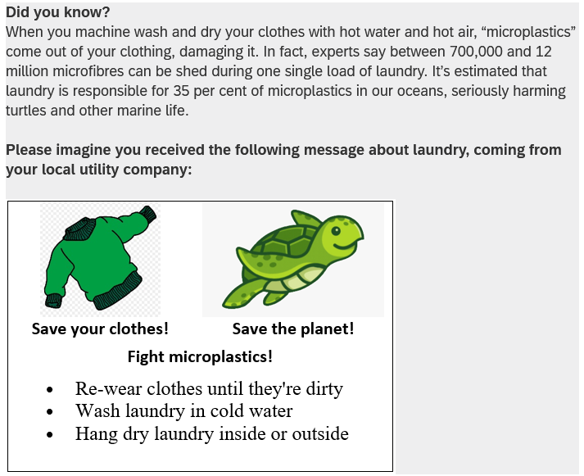
Microplastics sweater and turtle condition
Willingness to engage in conservation behaviour (1=Not at all likely, 5=Very likely):
Rewear clothes until dirty,
Combine small loads into large loads,
Wash laundry in cold water,
Hang dry laundry inside or outside
Image credit: https://www.pngkey.com/maxpic/u2w7w7u2o0q8o0r5/

Slide 24
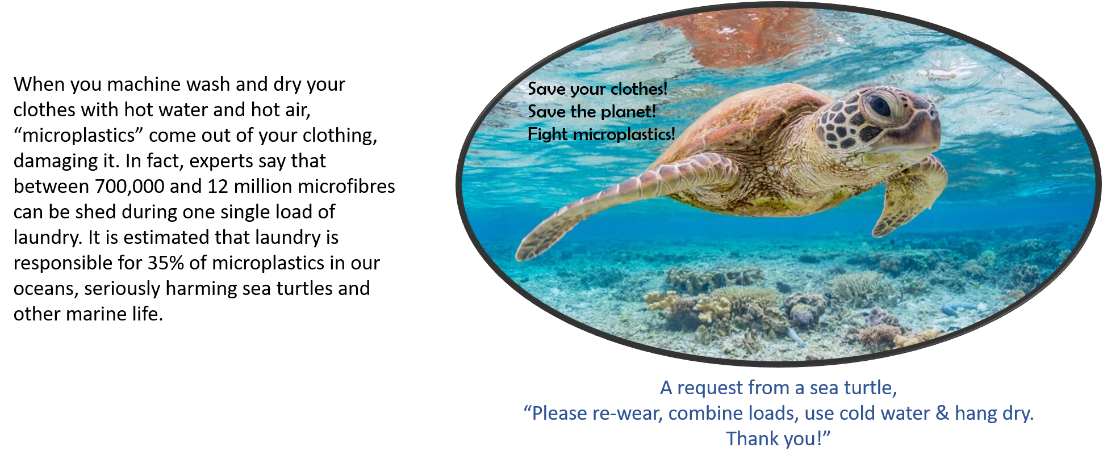
Pilot Surveys – Survey 4
Microplastics turtle condition
Willingness to engage in conservation behaviour (1=Not at all likely, 5=Very likely): “Rewear clothes until dirty, Combine small loads into large loads, Wash laundry in cold water, Hang dry laundry inside or outside

Slide 25
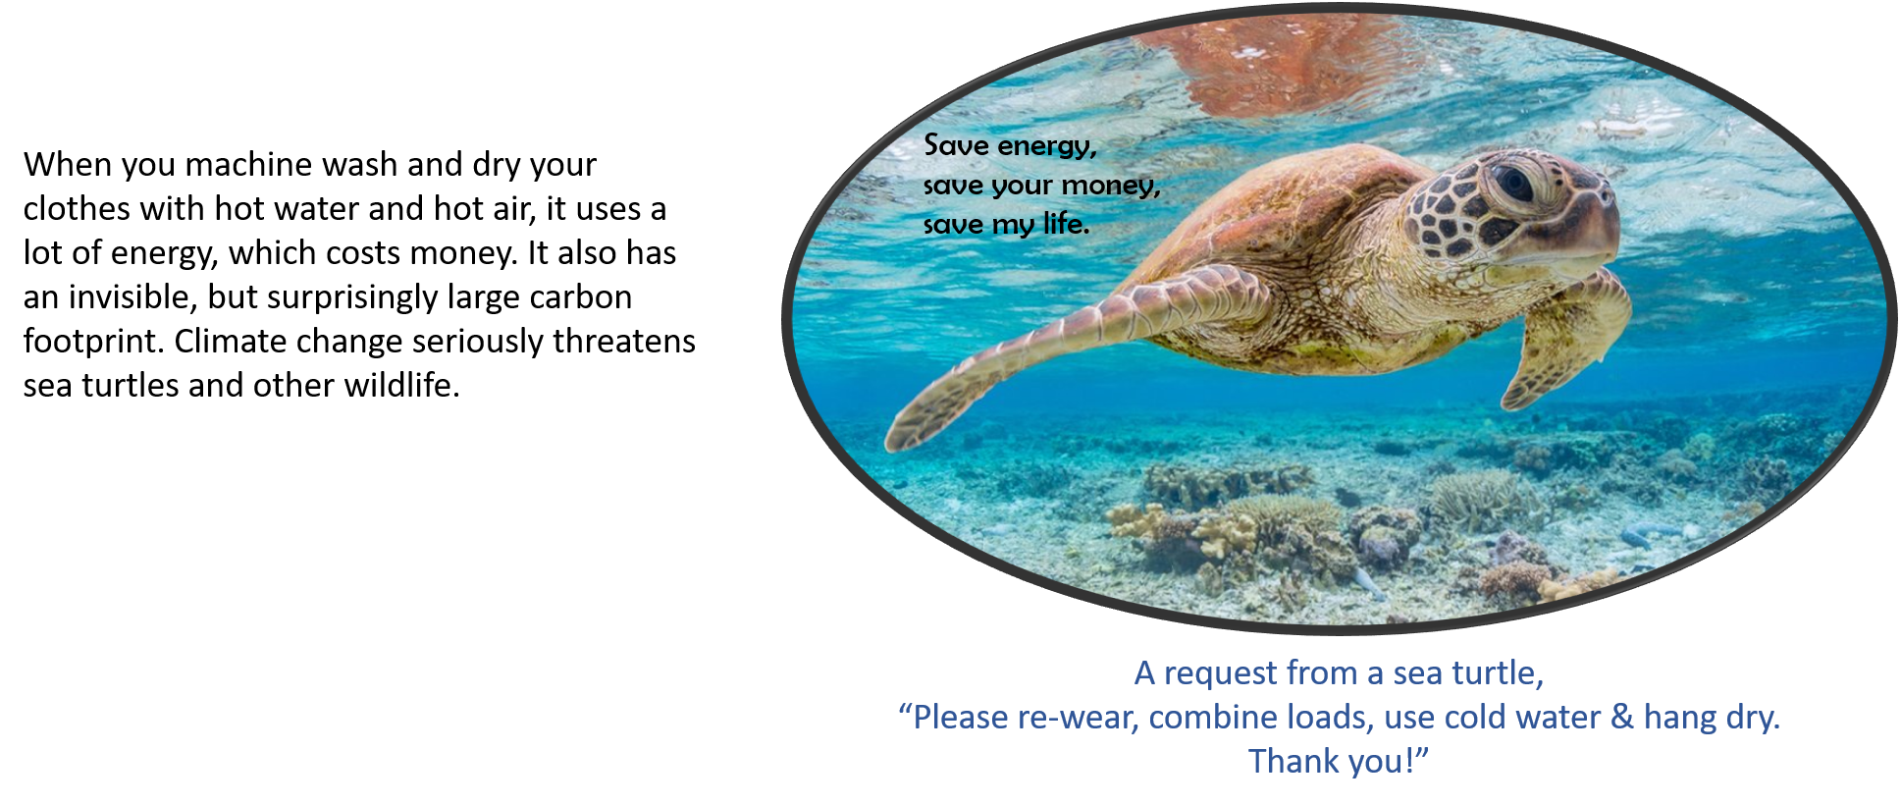
Pilot Surveys – Survey 4
Energy turtle condition

Slide 26
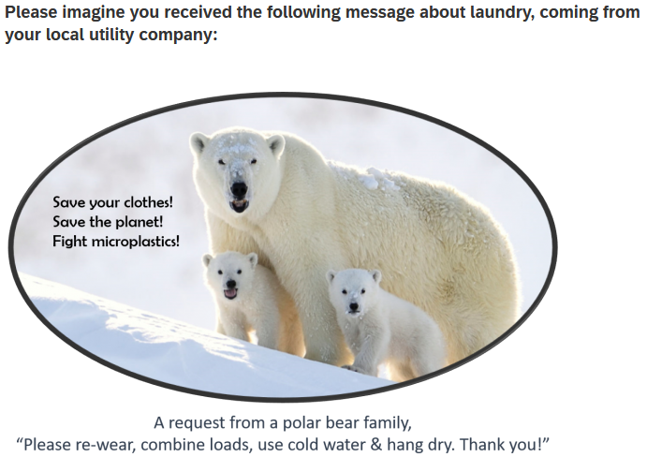
Pilot Surveys – Survey 4
Microplastics bear condition

Slide 27
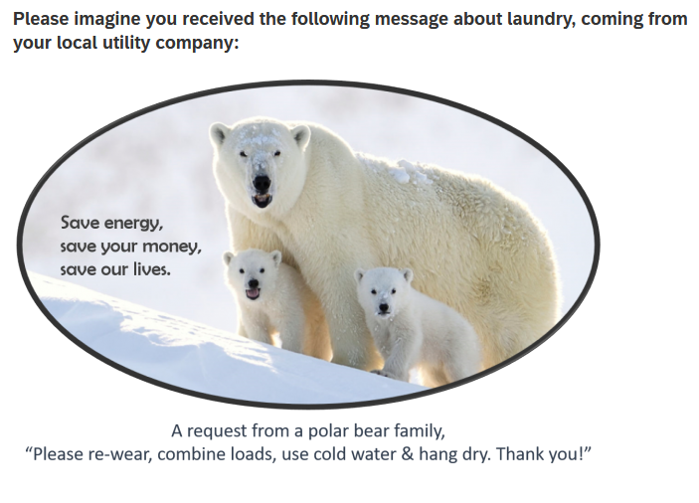
Pilot Surveys – Survey 4
Energy bear condition

Slide 28
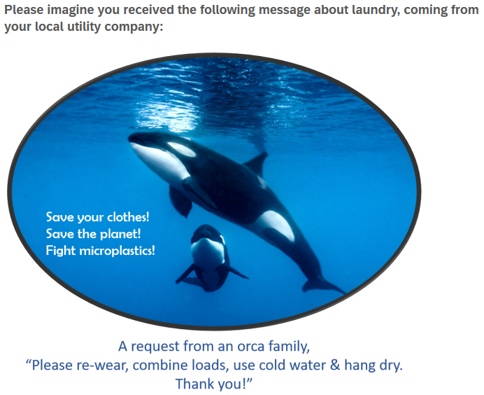
Pilot Surveys – Survey 4
Microplastics orcas condition

Slide 29
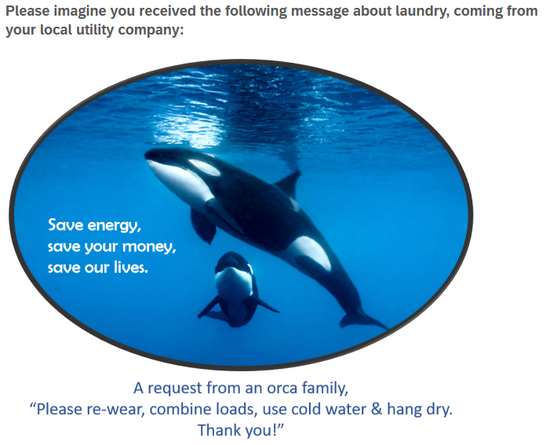
Pilot Surveys – Survey 4
Energy orcas condition

Slide 30
Pilot Survey 4
Which condition do you predict was most effective in Pilot Survey 4?
Control
Micro sweater + turtle
Micro turtles
Energy turtles
Micro bears
Energy bears
Micro orcas
Energy orcas
Null results

Slide 31
Pilot Surveys – Survey 4
Label | Place decal | Cold Water | Rewear | Combine Load | Hang Dry | Average
Control (n=48) |  | 3.6 | 3.4 | 4.2 | 3.0 | 3.5
Microplastics Sweater (n=42) | 3.5 | 4.1* | 4.0* | 4.4 | 3.2 | 3.9
Microplastics Turtle (n=48) | 3.5 | 4.2* | 3.9* | 4.4 | 3.2 | 4.0
Microplastics Polar (n=45) | 3.6 | 3.9 | 3.6 | 4.3 | 3.2 | 3.7
Microplastics Orca (n=45) | 3.6 | 3.9 | 3.7 | 4.3 | 3.2 | 3.8
Carbon turtle (n=40) | 3.1 | 4.1 | 3.7 | 4.2 | 3.1 | 3.7
Carbon Polar (n=45) | 3.1 | 3.8 | 3.6 | 4.3 | 3.1 | 3.7
Carbon orca (n=40) | 3.5 | 3.9 | 3.6 | 4.1 | 3.1 | 3.7
Note: * = significantly different from control, p < .05
Takeaway: Microplastic messaging with sweater and/or turtle were the most effective

Slide 32
Main Study Design

Slide 33
Study Design: Participants
1,210 BC Hydro customers recruited from BC Hydro’s Team Power Smart program and completed the first survey
Follow-up surveys every 3 months, for 1 year total
Must have Washing Machine & Clothes Dryer and pay BC Hydro bill
64% women, mean age = 57
Notes:
Note: 1,647 agreed to participate in advance, but only 1,158 completed the time 1 survey.

Slide 34
Target Laundry Behaviours
Re-wear
Combine loads
Use cold water
Hang dry clothes

Slide 35
Study Design: Overview
Primary IV: Participants randomly assigned to one of six conditions
  Control (no decal)
  Control (QR logging decal)
  Turtle appeal to change 4 behaviours
  Fleece appeal to change 4 behaviours
  Turtle + fleece appeal to change 4 behaviours
  Turtle + fleece appeal to hang dry
Primary DVs:
  Laundry behaviour change intentions
  Self-report (retrospective), every 3 months for one year
  Ongoing log of laundry behaviour for one year
  Energy meter data (hourly level) for one year, including 1-year prior history

Slide 36
Control (no decal)

Slide 37
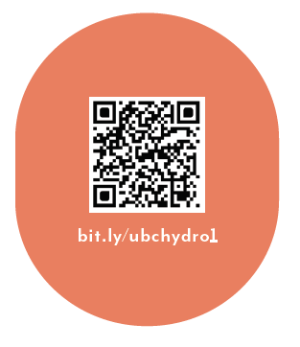
Control (logging decal only)
As part of your participation in this study, we will mail you a decal to put on your washer or dryer, which will look like the following:

Slide 38
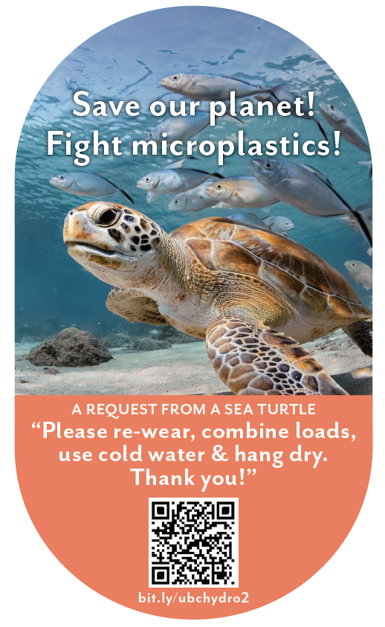
Sea Turtle + Bundled
When you machine wash and dry your clothes with hot water and hot air, “microplastics” come out of your clothes. In fact, experts say that between 700,000 and 12 million microfibres can be shed during one single load of laundry. It is estimated that laundry is responsible for 35% of microplastics in our oceans, seriously harming sea turtles and other marine life.
You can save our planet by:
- Re-wearing clothes more often
- Combining loads to run fewer, larger loads of laundry
- Washing laundry with cold water, rather than hot water or warm water
- Hanging clothes to dry (inside or outside), rather than machine-drying clothes
As part of your participation in this study, we will mail you a decal to put on your washer or dryer, which will look like the following:

Slide 39
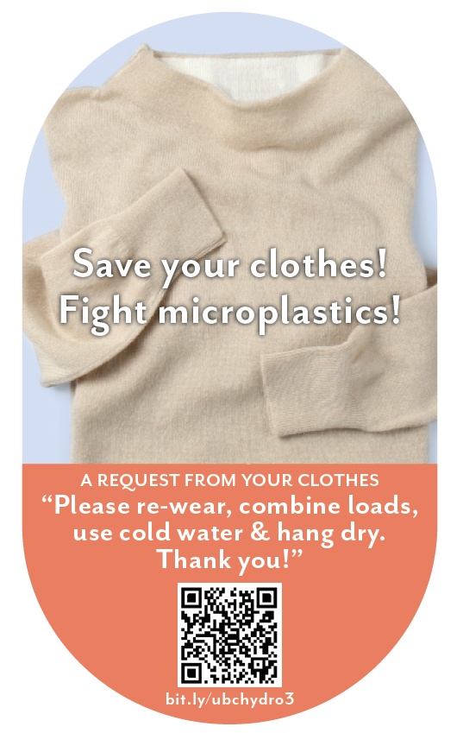
Clothing + Bundled
When you machine wash and dry your clothes with hot water and hot air, “microplastics” come out of your clothes. In fact, experts say that between 700,000 and 12 million microfibres can be shed during one single load of laundry. This breaks down the fabric in your clothes, damaging it and shortening the amount of time you’ll be able to enjoy wearing it.
You can save your clothes by:
- Re-wearing clothes more often
- Combining loads to, run fewer, larger loads of laundry
- Washing laundry with cold water, rather than hot water or warm water
- Hanging clothes to dry (inside or outside), rather than machine-drying clothes
As part of your participation in this study, we will mail you a decal to put on your washer or dryer, which will look like the following:

Slide 40
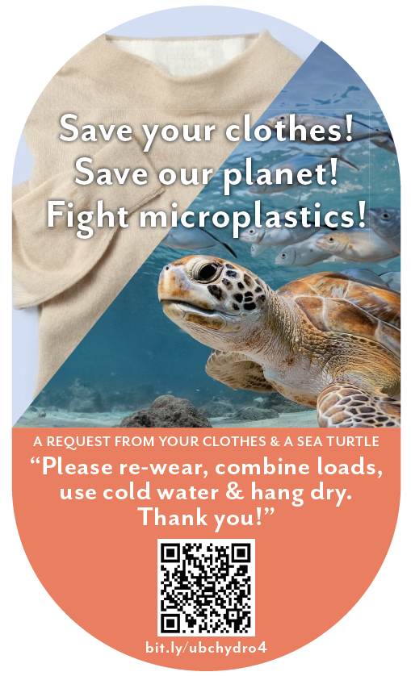
Turtle + Clothing + Bundled
When you machine wash and dry your clothes with hot water and hot air, “microplastics” come out of your clothes. In fact, experts say that between 700,000 and 12 million microfibres can be shed during one single load of laundry. This breaks down the fabric in your clothes, damaging it and shortening the amount of time you’ll be able to enjoy wearing it. It is also estimated that laundry is responsible for 35% of microplastics in our oceans, seriously harming sea turtles and other marine life.
You can save your clothes and save our planet by:
- Re-wearing clothes more often
- Combining loads to, run fewer, larger loads of laundry
- Washing laundry with cold water, rather than hot water or warm water
- Hanging clothes to dry (inside or outside), rather than machine-drying clothes
As part of your participation in this study, we will mail you a decal to put on your washer or dryer, which will look like the following:

Slide 41
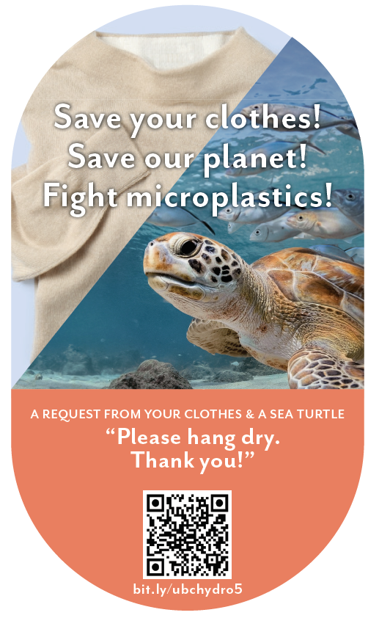
Turtle + Clothing + Hang Dry
When you machine wash and dry your clothes with hot water and hot air, “microplastics” come out of your clothes. In fact, experts say that between 700,000 and 12 million microfibres can be shed during one single load of laundry. This breaks down the fabric in your clothes, damaging it and shortening the amount of time you’ll be able to enjoy wearing it. It is also estimated that laundry is responsible for 35% of microplastics in our oceans, seriously harming sea turtles and other marine life.
You can save your clothes and save our planet by:
- Hanging clothes to dry (inside or outside), rather than machine-drying clothes
As part of your participation in this study, we will mail you a decal to put on your washer or dryer, which will look like the following:

Slide 42
Hypotheses

Slide 43
Predictions?
Which condition do you predict was most effective overall, in the main study?
(across intentions, self-report, logged data, and meter data, and over time)
Control
QR Control
Micro Turtle + Bundled Msg
Micro Fleece + Bundled Msg
Micro Turtle + Fleece + Bundled Msg
Micro Turtle + Fleece + Hang Dry
Null results

Slide 44
Hypotheses
Pre-registered at https://aspredicted.org/WWZ_WQ3
H1: Decals will improve intentions
H2: Decal targeting hang-dry will be more effective for that behaviour, less effective for others
H3: The combined motivation decal (turtle + fleece) will improve intentions on all four behaviours (vs control conditions)

Slide 45
Intentions Results

Slide 46
Intentions to engage in efficient laundry behaviours
Label | Cold Water | Rewear | Combine Load | Hang Dry | Average
Control (n=217) | 3.35 | 3.24 | 3.27 | 3.53 | 3.34
QR Scan Only Control (n=185) | 3.25 | 3.10 | 3.19 | 3.44 | 3.25
Sea turtle + bundled msg (n=189) | 3.61₁ ₂ | 3.47₁ ₂ | 3.46₁ ₂ | 3.60 | 3.53₁ ₂
Fleece + bundled msg (n=200) | 3.58₁ ₂ | 3.52₁ ₂ | 3.48₁ ₂ | 3.61₂ | 3.55₁ ₂
Sea turtle + fleece + bundled msg (n=184) | 3.60₁ ₂ | 3.42₁ ₂ | 3.40₁ ₂ | 3.54 | 3.49₁ ₂
Sea turtle + fleece + hang dry msg (n=189) | 3.56₁ ₂ | 3.42₁ ₂ | 3.38₂ | 3.77₁ ₂ | 3.53₁ ₂
Note: Subscript 1 = mean is significantly different from control, Subscript 2 = mean is significantly different from QR scan only control. Subscript 1 and 2 = mean is significantly different from both control conditions

Slide 47
Intentions to engage in efficient laundry behaviours
Summary:
All decals increased intentions to improve behaviours
Roughly equally effective on intentions

Slide 48
Self-report Results

Slide 49
Self-report Results
Takeaway:
From S1 to S4, participants were marginally less likely to report engaging in laundry efficient behaviours for the control conditions (p’s <.1). Sea turtle+fleece+hang dry message and Sea turtle bundled message was more effective than control conditions at S4 (p’s <.08)

Slide 50
Self-report Results
Takeaway:
From S1 to S4, participants were marginally less likely to report engaging in laundry efficient behaviours for the control conditions (p’s <.1). Sea turtle+fleece+hang dry message and Sea turtle bundled message was more effective than control conditions at S4 (p’s <.08)

Slide 51
Self-report of efficient laundry behaviours
Summary:
Two decal messages improved self-reported behaviours over time:
Microplastics turtle + bundled msg
and
Microplastics turtle + fleece+hang-dry msg

Slide 52
Behaviour Logging Results

Slide 53
Behaviour Logging Results: QR Code Usage
BONUS: What percentage of laundry loads were logged using the QR code (vs clicking the email link or typing in the URL directly)?
Predictions? Answer in the chat!

Slide 54
Behaviour Logging Results: QR Code Usage
 | Number | %
Via URL | 12,485 | 32%
Via QR Code | 26,460 | 68%
Total | 38,945 | 100%

Slide 55
Behaviour Logging Results
Condition | n | Total Washed | Total Dried | Ratio (Dried / Washed)
Control (Decal) | 137 | 72.6 | 56.4 | 0.77
Turtle + Bundle | 125 | 50.2*** | 34.9*** | 0.68*
Clothes + Bundle | 113 | 67.5 | 51.8 | 0.75
Turtle + Clothes + Bundle | 109 | 63.4 | 46.1† | 0.73
Turtle + Clothes + Hang Dry | 127 | 64.2 | 39.4** | 0.63***
Symbols indicate significant differences from control. † p < .1, ** p < .01, *** p < .001

Slide 56
Logging of efficient laundry behaviours
Summary:
Two decal messages improved logged behaviours over time:
Microplastics turtle + bundled msg decreased washing and drying
and
Microplastics turtle + fleece+hang-dry msg decreased drying

Slide 57
Energy Meter Results

Slide 58
Energy Meter Results: kWh per Day across all participants
Condition | Pre | Post | Change
Control (No survey) | 22.74 | 23.36 | 0.62
Control (No decal) | 21.21 | 21.54 | 0.32
Control (QR decal) | 22.93 | 23.14 | 0.21
Turtle + Bundle Msg | 23.02 | 23.79 | 0.77
Fleece + Bundle Msg | 22.04 | 22.77 | 0.72
Turtle + Fleece + Bundle Msg | 21.26 | 22.16 | 0.9
Turtle + Fleece + Hang Dry Msg | 22.06 | 22.54 | 0.48
No significant differences between conditions
Notes:
The average household electricity consumption kWh per day is 28.9 kWh in the USA
The Texas average kilowatt usage per day is 39.2 kWh
https://electricityplans.com/kwh-kilowatt-hour-can-power/

Slide 59
Energy Meter Results: kWh for logging participants
Condition | n | Total Energy | Wash Energy | Dry Energy | Dry Ratio
Control (Decal only) | 94 | 15,168 | 139 | 121 | 0.81
Turtle + Bundle Msg | 91 | 14,704 | 105† | 79* | 0.68**
Fleece + Bundle Msg | 98 | 15,778 | 141 | 121 | 0.8
Turtle + Fleece + Bundle Msg | 72 | 14,240 | 102† | 82* | 0.79
Turtle + Fleece + Hang Dry Msg | 92 | 14,410 | 122 | 86* | 0.69**
Symbols indicate significant differences from control. † p < .1, * p < .05, ** p < .01

Slide 60
Metered efficient laundry behaviours
Summary:
No significant change in energy usage, but data is noisy
When isolating laundry times, three condition were effective:
Turtle + bundled msg
Turtle + fleece + bundled msg
Turtle + fleece + hang dry

Slide 61
Conclusions

Slide 62
Summary: Decal Effectiveness vs Control
Condition | Intentions | Self-report | Logged Washing | Logged Drying | Metered Washing | Metered Drying
Turtle + Bundle | ✓ | ✓ | ✓ | ✓ | † | ✓
Fleece + Bundle | ✓
Turtle + Fleece + Bundle | ✓ |  |  |  | † | ✓
Turtle + Fleece + Hang Dry | ✓ | ✓ |  | ✓ |  | ✓

Slide 63
Conclusions
In the context of a motivated sample of BC laundry doers:
Decals can be an effective nudging tool for sustaining energy efficient behaviour over time; serves as a constant reminder & motivation; attractive image is important
Sometimes energy motivations are not the best way to change energy behaviours!
Most effective: combining a single, novel motivator (microplastics turtle) with multiple behaviour change requests
Not so effective in this context: self-interest (clothing, money)

Slide 64
Thank You!

Slide 65
Questions?

